Slide 1


ISCG7427 Mobile Development (StockHive App)
Quinton, Peter, Lorenzo, Lewis

Slide 2


What is stockhive?
StockHive is a small business inventory and order management app, designed for use by suppliers, admins, and customers.
What it does:
Enables bulk and per item ordering
Let’s suppliers manage inventory
Gives admins control over users and system data
Supports customers with a simple retail shopping experience

Slide 3
Initial architecture
Frontend: Java + XML Layouts
Backend: Firebase for cloud storage
Navigation: Multi-screen via buttons
Tech Stack: Android Studio, Firebase Realtime Database, Firebase Firestore Database

Slide 4

Key features (User type)

Slide 5
Customer role
Any email not ending in @admin.com or @supplier.com
Retail product browsing
Purchasing functions, shopping cart, viewing cart, checking out etc.

Slide 6
Supplier role
Registered email using @supplier.com
Add products to the inventory
View/Delete products in stock
Update product names and quantities
Firebase integration for real time inventory syncing

Slide 7
Admin role
Registered email ends with @admin.com
View all registered users (via Firestore)
Reset passwords via email
Delete users from Firebase
A simple control panel

Slide 8
Development challenges
Handling multiple activities for different roles
Setting up Firebase databases correctly
Ensuring clean, simple layouts across devices
Keeping navigation smooth between screens

Slide 9
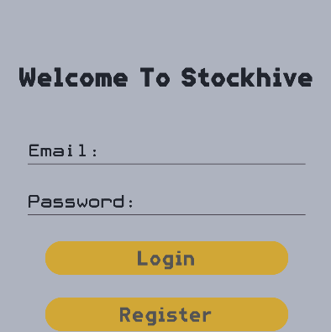

Live Demo
What we’ll show
Login and registration flow with role access
Admin panel
Supplier screens
Customer screens

Slide 10

Questions?

Slide 11

Thank you

